Slide 1
Today
Lecture 12: Quasiparticle tunneling --- theory
Discussion of quasiparticle tunneling in two parts:
Theory
Special tunneling effects and applications
Next time
Lecture 13: Quasiparticle tunneling --- applications

Slide 2
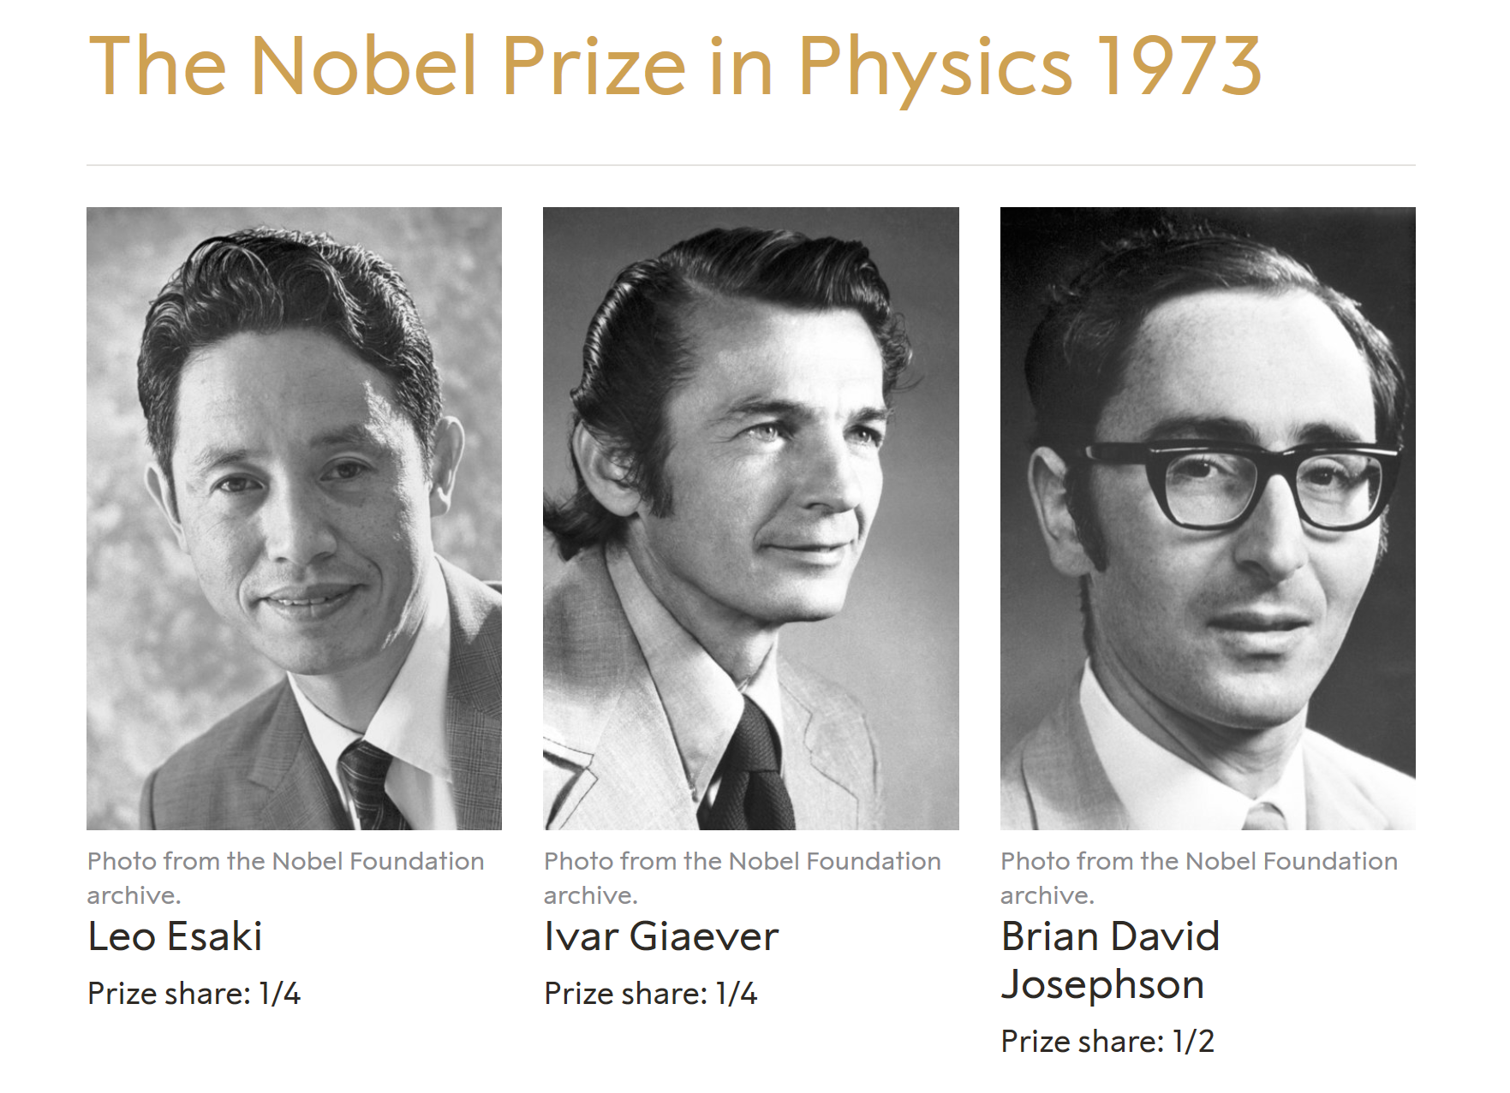
Tunneling
QM – illustrates insufficiency of CM
1930’s – mush work on QM tunneling theoretically
1958 – Esaki (Leo) SONY – tunnel diode (negative resistance)
1960 – Giaver (Ivar) GE – tunneling between metals (bought evaporator)
1962 – Josephson (Brian) Cambridge – Josephson effect
N – N Tunneling
Zero voltage – electrochemical potentials equalize
Apply voltage – electrochemical potentials shift by eV

Slide 3

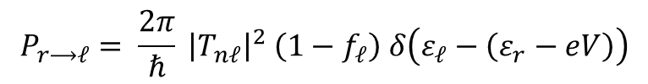
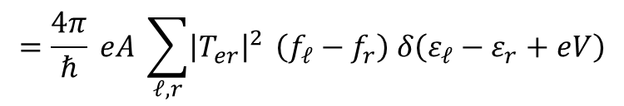
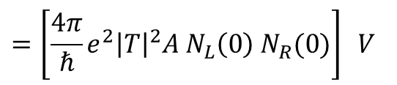
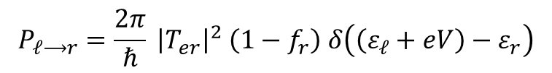
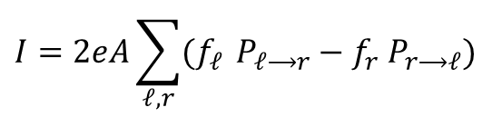
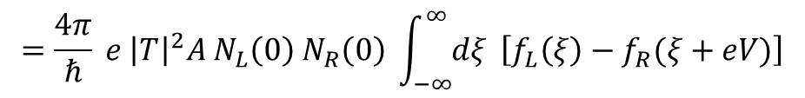



Golden Rule
$$P_{ℓ⟶r}=\frac{2π}{ℏ} {\left|T_{er}\right|}^{2} \left(1−f_{r}\right) δ\left(\left(ε_{ℓ}+eV\right)−ε_{r}\right)$$
Matrix elements: $\left|T_{re}\right|=\left|T_{er}\right|$
$$P_{r⟶ℓ}= \frac{2π}{ℏ} {\left|T_{nℓ}\right|}^{2} \left(1−f_{ℓ}\right) δ\left(ε_{ℓ}−\left(ε_{r}−eV\right)\right)$$
$$I=2eA\sum_{ℓ,r}{(f_{ℓ}} P_{ℓ⟶r}−f_{r} P_{r⟶ℓ})$$
$$=\frac{4π}{ℏ} eA \sum_{ℓ,r}{{\left|T_{er}\right|}^{2}} \left(f_{ℓ}−f_{r}\right) δ\left(ε_{ℓ}−ε_{r}+eV\right)$$
Assume ${\left|T_{er}\right|}^{2}$independent of energy $={\left|T\right|}^{2}$
Assume $f_{ℓ}, f_{r}$ depend on $ε_{ℓ}, ε_{r}$ (thermal equilibrium)
$$=\frac{4π}{ℏ} e {\left|T\right|}^{2}A \int_{−∞}^{∞}{dξ \left[f_{L}\left(ξ\right)−f_{R}\left(ξ+eV\right)\right]{ N}_{L}\left(ξ\right) N_{R}(ξ+eV)}$$
$$=\frac{4π}{ℏ} e {\left|T\right|}^{2}A N_{L}\left(0\right) N_{R}\left(0\right) \int_{−∞}^{∞}{dξ} \left[f_{L}\left(ξ\right)−f_{R}(ξ+eV)\right]$$
$$=\left[\frac{4π}{ℏ}e^{2}{\left|T\right|}^{2}A N_{L}\left(0\right) N_{R}(0)\right] V$$
$G_{NN}$ normal conductance
$$=G_{NN}V$$
Ohm’s Law valid

Slide 4
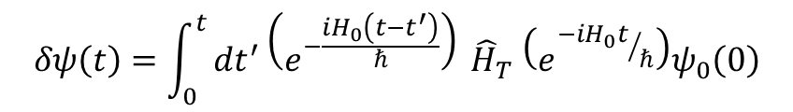
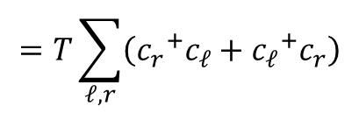
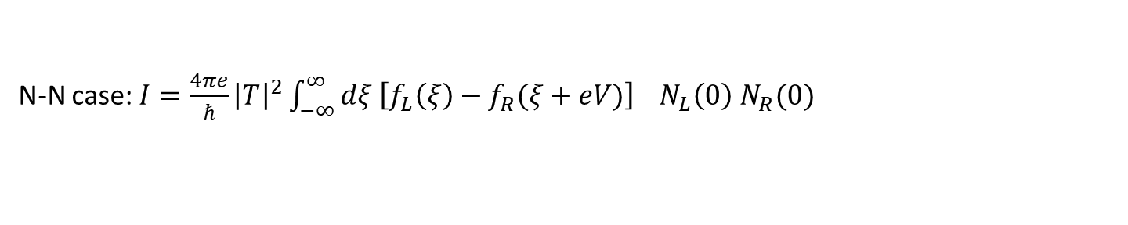
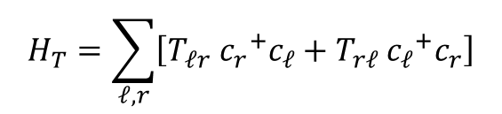
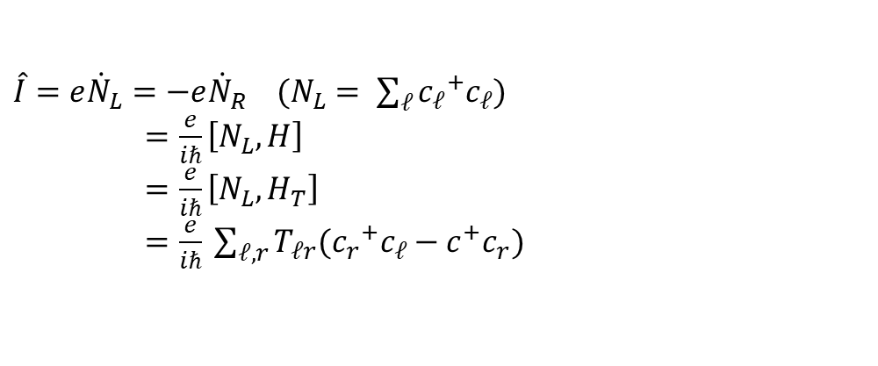
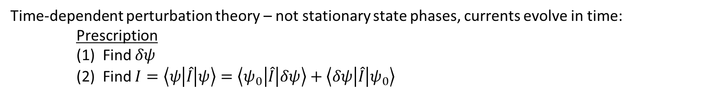

Tunneling Hamiltonian (Cohen, Falicov, etc.) 1962
$$H_{T}=\sum_{ℓ,r}{\left[T_{ℓr} {c_{r}}^{+}c_{ℓ}+T_{rℓ} {c_{ℓ}}^{+}c_{r}\right]}$$
$$=T\sum_{ℓ,r}{\left({c_{r}}^{+}c_{ℓ}+{c_{ℓ}}^{+}c_{r}\right)}$$
$$H=\left(H_{L}+H_{R}\right)+H_{T}⇒ ψ=ψ_{0}+δψ$$
Time-dependent perturbation theory – not stationary state phases, currents evolve in time:
Prescription
(1) Find $δψ$
(2) Find $I=\left\langle ψ\left|\hat{I}\right|ψ\right\rangle =\left\langle ψ_{0}\left|\hat{I}\right|δψ\right\rangle +\left\langle δψ\left|\hat{I}\right|ψ_{0}\right\rangle$
$$δψ\left(t\right)=\int_{0}^{t}{dt^{′}\left(e^{−\frac{iH_{0}\left(t−t^{′}\right)}{ℏ}}\right)} {\hat{H}}_{T} \left(e^{{−iH_{0}t}/ℏ}\right)ψ_{0}\left(0\right)$$
(1)
(2)
$\hat{I}=e{\dot{N}}_{L}=−e{\dot{N}}_{R}$ $(N_{L}= \sum_{ℓ}{{c_{ℓ}}^{+}c_{ℓ}})$
$=\frac{e}{iℏ}\left[N_{L}, H\right]$
$=\frac{e}{iℏ}\left[N_{L}, H_{T}\right]$
$=\frac{e}{iℏ} \sum_{ℓ,r}{T_{ℓr}({c_{r}}^{+}c_{ℓ}−c^{+}c_{r})}$
N-N case: $I=\frac{4πe}{ℏ}{\left|T\right|}^{2}\int_{−∞}^{∞}{dξ \left[f_{L}\left(ξ\right)−f_{R}(ξ+eV)\right]} N_{L}\left(0\right) N_{R}(0)$

Slide 5

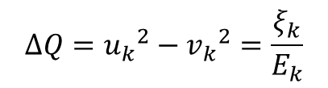



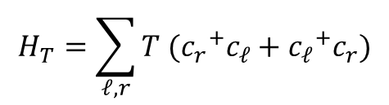

Superconductor Tunneling
$$H_{T}=\sum_{ℓ,r}{T ({c_{r}}^{+}c_{ℓ}+{c_{ℓ}}^{+}c_{r})}$$
Perturbation: $c^{′}s→γ^{′}s$– OK for one SC
$${γ_{k_{0}}}^{+}=u_{k}{c_{k↑}}^{+}−v_{k}c_{−k↓}$$
$$ΔQ={u_{k}}^{2}−{v_{k}}^{2}=\frac{ξ_{k}}{E_{k}}$$
$${γ_{k_{1}}}^{+}=u_{k}{c_{−k↓}}^{+}+v_{k}c_{k↑}$$
Does not work for two systems exchanging particles:
1) electrochemical potentials different
$$φ_{L}=μ_{L}+eV_{L}, φ_{R}=μ_{R}$$
2) ${ γ}_{ }$’s do not transfer one electron across barrier

Slide 6


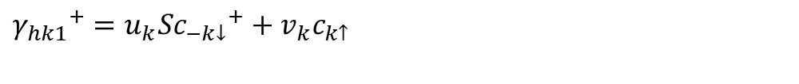
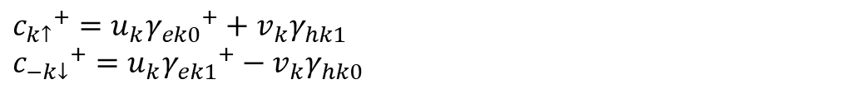
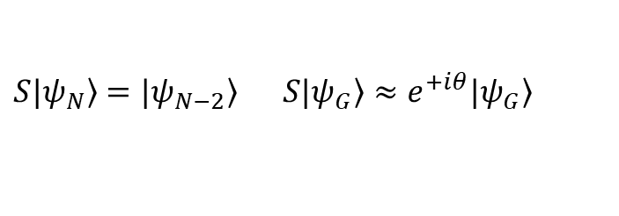



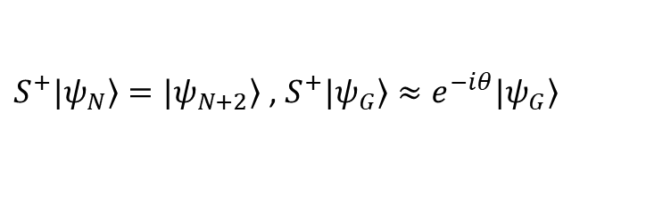



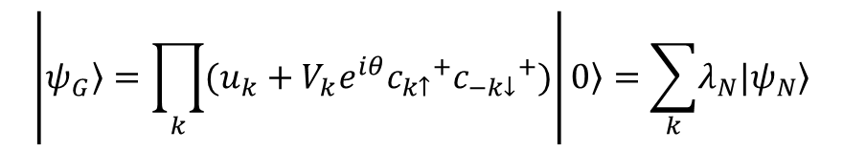
Josephson operators
ENERGY
$${γ_{ek0}}^{+}=u_{k}{c_{k↑}}^{+}−v_{k}S^{+}c_{−k↓}$$
$$E_{k}+μ$$
$${γ_{hk0}}^{+}=u_{k}S{c_{k↑}}^{+}−v_{k}c_{−k↓}$$
$$E_{k}−μ$$
$${γ_{ek1}}^{+}=u_{k}c^{+}+v_{k}S^{+}c_{k↑}$$
$$E_{k}+μ$$
$${γ_{hk1}}^{+}=u_{k}S{c_{−k↓}}^{+}+v_{k}c_{k↑}$$
$$E_{k}−μ$$
$S^{+},S$are BOSON pair operators such that $S^{+}S=SS^{+}=1$
(1) ${γ_{hk}}^{+}=S{γ_{ek}}^{+}$so ${γ_{hk}}^{+}$ and ${γ_{ek}}^{+}$ are same excitations with different numbers of pairs
(2) Each ${γ_{ek}}^{+}$ adds one electron of charge
Each ${γ_{hk}}^{+}$ removes one electron of charge
$$e^{i\left(\frac{N}{2}\right)φ}$$
(3) Motivation:
$$\left|\left.ψ_{G}\right\rangle =\prod_{k}{(u_{k}+V_{k}e^{iθ}{c_{k↑}}^{+}{c_{−k↓}}^{+})}\right|\left.0\right\rangle =\sum_{k}{\left.λ_{N}|ψ_{N}\right\rangle }$$
Again demonstrates N, θ conjugate variables
$\left.S^{+}|ψ_{N}\right\rangle =|\left.ψ_{N+2}\right\rangle$ , $\left.S^{+}|ψ_{G}\right\rangle ≈e^{−iθ}|\left.ψ_{G}\right\rangle$
$${c_{k↑}}^{+}=u_{k}{γ_{ek0}}^{+}+v_{k}γ_{hk1}$$
$${c_{−k↓}}^{+}=u_{k}{γ_{ek1}}^{+}−v_{k}γ_{hk0}$$
$\left.S|ψ_{N}\right\rangle =|\left.ψ_{N−2}\right\rangle$ $\left.S|ψ_{G}\right\rangle ≈e^{+iθ}|\left.ψ_{G}\right\rangle$

Slide 7
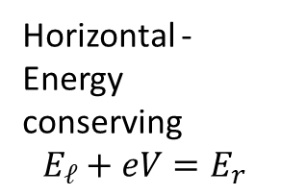
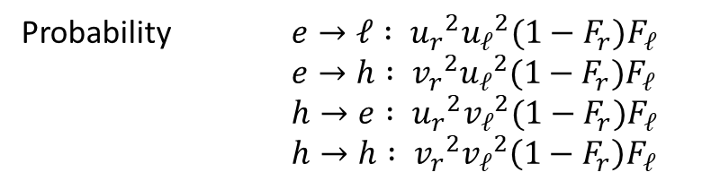


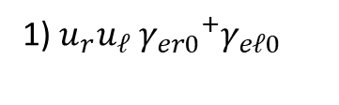


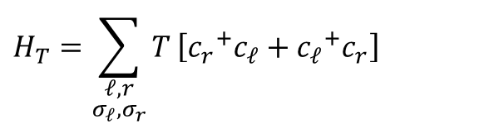


$$H_{T}=\sum_{\begin{aligned}ℓ,r \\ σ_{ℓ},σ_{r}\end{aligned}}{T}\left[{c_{r}}^{+}c_{ℓ}+{c_{ℓ}}^{+}c_{r}\right]$$
$${c_{r↑}}^{+}c_{ℓ↑}=\left(u_{r}{γ_{er0}}^{+}+v_{r}γ_{hr1}\right)\left(u_{ℓ}γ_{eℓ0}+v_{ℓ}{γ_{hℓ1}}^{+}\right)$$
4 kinds of terms:
1) $u_{r}u_{ℓ} {γ_{er0}}^{+}γ_{eℓ0}$
4 possible processes (and reverse processes)
Horizontal - Energy conserving
$$E_{ℓ}+eV=E_{r}$$
$$L$$
$$R$$
Probability $e→ℓ : {u_{r}}^{2}{u_{ℓ}}^{2}(1−F_{r})F_{ℓ}$
$e→h : {v_{r}}^{2}{u_{ℓ}}^{2}(1−F_{r})F_{ℓ}$
$h→e : {u_{r}}^{2}{v_{ℓ}}^{2}(1−F_{r})F_{ℓ}$
$h→h : {v_{r}}^{2}{v_{ℓ}}^{2}\left(1−F_{r}\right)F_{ℓ}$
$${u_{ℓ}}^{2}$$
$${v_{ℓ}}^{2}$$
$$(1−F_{r})F_{ℓ}$$
Coherence factors fall out!
NB: $u_{k}\left(ξ_{k}\right)=v(−ξ_{k})$

Slide 8
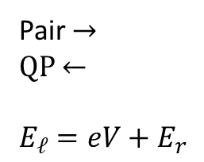
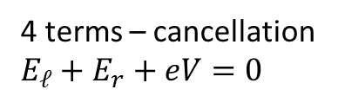





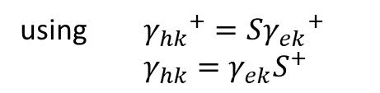
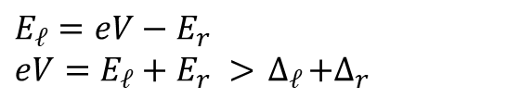
2) $v_{r}v_{ℓ} γ_{hr1}{γ_{hℓ1}}^{+}=v_{r}v_{ℓ} γ_{ℓr1}({S_{r}}^{+}S_{ℓ}){γ_{eℓ1}}^{+}$
Pair →
QP ←
$$E_{ℓ}=eV+E_{r}$$
using ${γ_{hk}}^{+}=S{γ_{ek}}^{+}$
$γ_{hk}=γ_{ek}S^{+}$
or
4 processes (coherence factor cancel):
Probability ~ $(1−F_{ℓ})F_{r}$
$$E_{ℓ}=eV−E_{r}$$
$$eV=E_{ℓ}+E_{r} >{ ∆}_{ℓ}+∆_{r}$$
3) $u_{r}v_{ℓ} {γ_{er0}}^{+}{γ_{hℓ1}}^{+}=u_{r}v_{ℓ}{γ_{er0}}^{+}S_{ℓ}{γ_{eℓ1}}^{+}$
4 processes (coherence factor cancel):
2Δ threshold for pairbreaking to contribute to the current
Probability ~ $(1−F_{ℓ})(1−F_{r})$
4 terms – cancellation
$$E_{ℓ}+E_{r}+eV=0$$
4) $v_{r}u_{ℓ} γ_{hr1}γ_{eℓ0}=v_{r}u_{ℓ}γ_{er1}{S_{r}}^{+}γ_{e0}$
Cannot conserve energy ⇒ does not happen

Slide 9
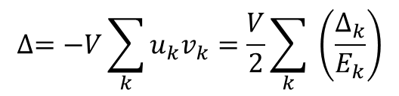






Observations:
Reverse terms R→L : similar form
    Systems distinct ⇒ no identical terms (interference effects) Smaller in magnitude (net current due to V applied)
b) Tunneling creates (and can be used to measure):
    1. Charge (current)
  2. Charge imbalance Q*
$$e→e or h$$
Probability
$$\sim {u_{ℓ}}^{2}$$
For
$$\left|ℓ\right|>k_{F},$$
$${v_{ℓ}}^{2}>{u_{ℓ}}^{2}$$
so Q* transferred
$$h→e or h$$
Probability
$$\sim {v_{ℓ}}^{2}$$
3. Gap excitation
transfer excess qp’s and excite to higher energies
higher E → raise gap
$$∆=−V\sum_{k}{u_{k}v_{k}=\frac{V}{2}\sum_{k}{ \left(\frac{∆_{k}}{E_{k}}\right)}}$$
excess → lower gap
4. Phonons (heat) created in relaxation to thermal equilibrium
(2-4) non-equilibrium distributions of qp’s, phonons --- scale depends on decay rates

Slide 10

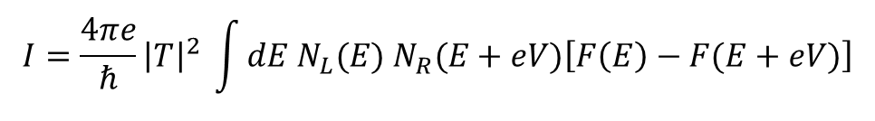

c) Josephson effect – pitched out *
Type (1) L→R : $u_{r}u_{ℓ} {γ_{er}}^{+}γ_{eℓ}$
Type (2) R→L : $v_{r}v_{ℓ} γ_{eℓ}\left(S_{ℓ}+S_{r}\right){γ_{er}}^{+}=−v_{r}v_{ℓ}e^{i\left(θ_{r}−θ_{ℓ}\right)}{γ_{er}}^{+}γ_{eℓ}$
terms differ by a pair
(number of particles different)
phase factor
(d) Coherence factors gone
Proceed by TDPT ⇒ $\left\langle ψ_{0}\left|\hat{I}\right|δψ\right\rangle \sim \left\langle ψ_{0}\left|\hat{I}\hat{H_{1}}\right|ψ_{0}\right\rangle$
-- or --
Use Fermi Golden Rule (as we began)
$$I=\frac{4πe}{ℏ}{\left|T\right|}^{2} \int{dE N_{L}(E) N_{R}(E+eV)\left[F\left(E\right)−F(E+eV)\right]}$$
N, F for excitations (normal or SC)

Slide 11
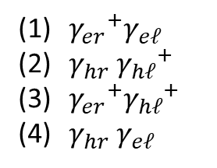
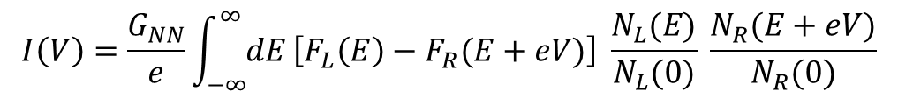
SEMICONDUCTOR MODEL FOR TUNNELING
$$I\left(V\right)=\frac{G_{NN}}{e}\int_{−∞}^{∞}{dE}\left[F_{L}\left(E\right)−F_{R}(E+eV)\right] \frac{N_{L}(E)}{N_{L}(0)} \frac{N_{R}(E+eV)}{N_{R}(0)}$$
electron
excitations
${γ_{er}}^{+}γ_{eℓ}$
$γ_{hr}{{ γ}_{hℓ}}^{+}$
${γ_{er}}^{+}{γ_{hℓ}}^{+}$
$γ_{hr}{ γ}_{eℓ}$
hole
excitations
“Microscopic” model
Energy conserving transitions are horizontal
Emphasizes density of states

Slide 12
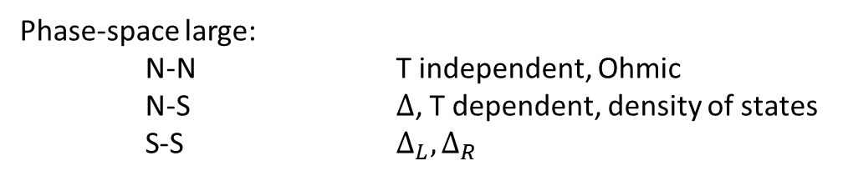
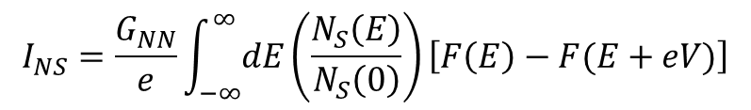


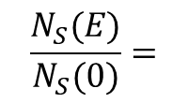

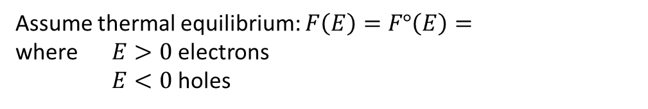
Phase-space large:
N-N T independent, Ohmic
N-S ∆, T dependent, density of states
S-S $∆_{L}, ∆_{R}$
NIS Tunneling
$$I_{NS}=\frac{G_{NN}}{e}\int_{−∞}^{∞}{dE}\left(\frac{N_{S}\left(E\right)}{N_{S}\left(0\right)}\right)\left[F\left(E\right)−F(E+eV)\right]$$
$$\frac{1}{e^{{ E}/{kBT}}+1}$$
Assume thermal equilibrium: $F\left(E\right)=F°\left(E\right)=$
where $E>0$electrons
$E<0$holes
$$0, \left|E\right|<∆$$
$$\frac{N_{S}(E)}{N_{S}(0)}=$$
$$\frac{\left|E\right|}{\sqrt{E^{2}−∆^{2}}}, \left|E\right|>∆$$

Slide 13

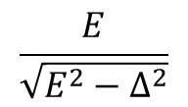



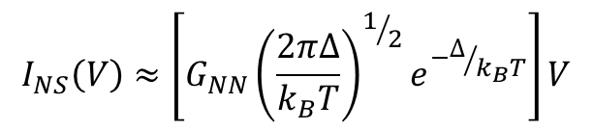

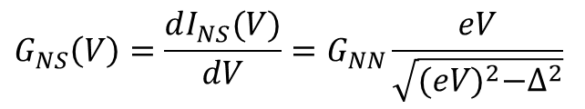


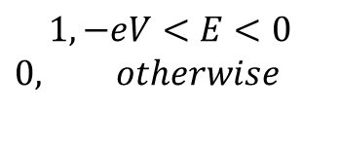
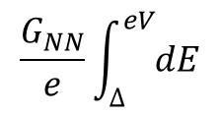
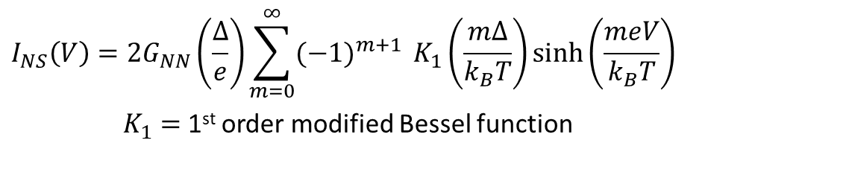
$$F\left(E\right)−F\left(E+eV\right)=$$
$$1, −eV<E<0$$
$$0, otherwise$$
$$\frac{G_{NN}}{e}\int_{∆}^{eV}{dE}$$
$$\frac{E}{\sqrt{E^{2}−∆^{2}}}$$
$$I_{NS}\left(V\right)=$$
$=\frac{G_{NN}}{e}\sqrt{{(eV)}^{2}−∆^{2}}$
$$G_{NS}\left(V\right)=\frac{dI_{NS}(V)}{dV}=G_{NN}\frac{eV}{\sqrt{{(eV)}^{2}−∆^{2}}}$$
$$eV>∆$$
$$T>0$$
$$I_{NS}\left(V\right)=2G_{NN}\left(\frac{∆}{e}\right)\sum_{m=0}^{∞}{{(−1)}^{m+1}} K_{1}\left(\frac{m∆}{k_{B}T}\right)\sinh\left(\frac{meV}{k_{B}T}\right)$$
$K_{1}=$ 1st order modified Bessel function
$$I_{NS}\left(V\right)≈\left[G_{NN}{\left(\frac{2π∆}{k_{B}T}\right)}^{1/2}e^{−∆/{k_{B}T}}\right]V$$
$$eV, T<∆$$
∴ Ohmic, but $G_{NS}≪G_{NN}$

Slide 14
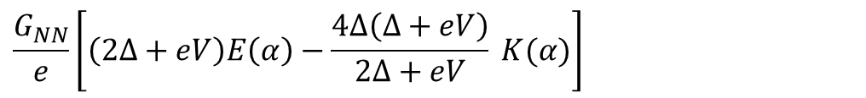
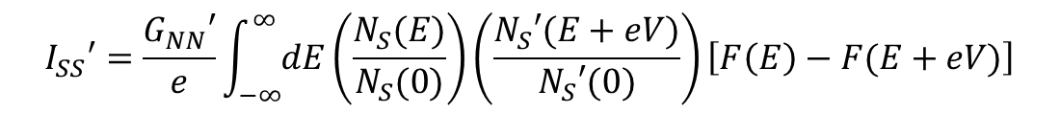







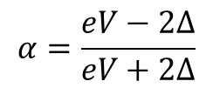
SIS’ Tunneling
$$I_{SS}′=\frac{G_{NN}′}{e}\int_{−∞}^{∞}{dE}\left(\frac{N_{S}(E)}{N_{S}(0)}\right)\left(\frac{N_{S}′(E+eV)}{N_{S}′(0)}\right)\left[F\left(E\right)−F(E+eV)\right]$$
Solution in elliptical integrals
$$T=0$$
$$∆=∆′$$
Identical SC
0
$$eV<2∆$$
$$I_{SS}=$$
$\left(\frac{π∆}{2ℓ}\right)G_{NN}$
$$eV=2∆$$
$$\frac{G_{NN}}{e}\left[\left(2∆+eV\right)E\left(α\right)−\frac{4∆\left(∆+eV\right)}{2∆+eV} K(α)\right]$$
$$eV>2∆$$
elliptic integrals
$$α=\frac{eV−2∆}{eV+2∆}$$
Heat ⇒ smears out, lower gap

Slide 15
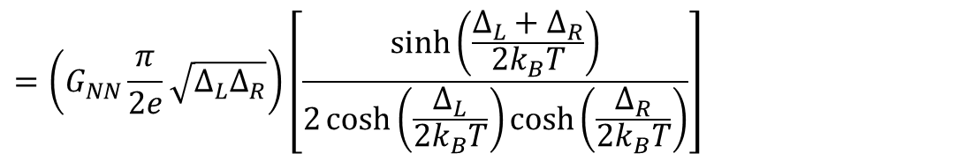

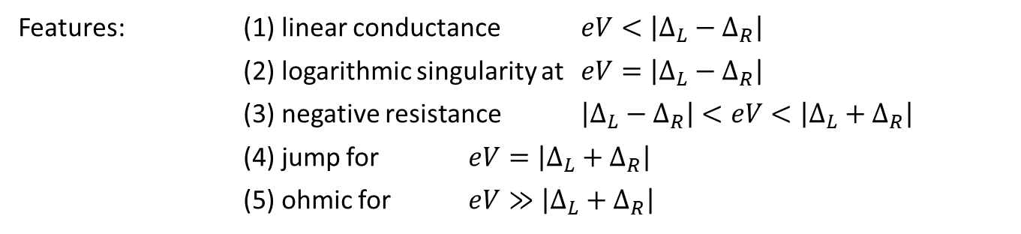


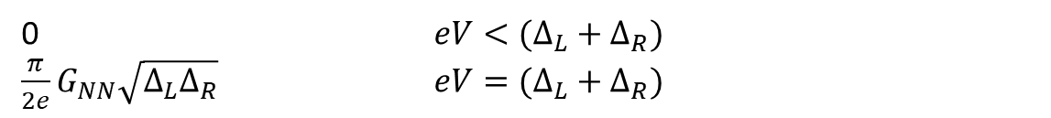

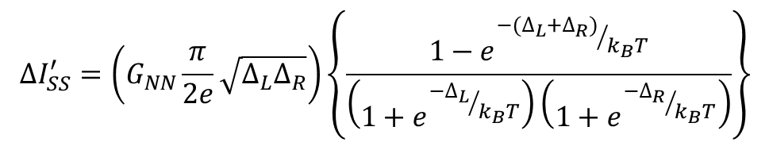
$$T=0$$
$$∆_{L}≠∆_{R}$$
0 $eV<(∆_{L}+∆_{R})$
$\frac{π}{2e}G_{NN}\sqrt{∆_{L}∆_{R}}$ $eV=(∆_{L}+∆_{R})$
$$I_{SS}^{′}=$$
$$T≠0$$
Features: (1) linear conductance $eV<\left|∆_{L}−∆_{R}\right|$
(2) logarithmic singularity at $eV=\left|∆_{L}−∆_{R}\right|$
(3) negative resistance $\left|∆_{L}−∆_{R}\right|<eV<\left|∆_{L}+∆_{R}\right|$
(4) jump for $eV=\left|∆_{L}+∆_{R}\right|$
(5) ohmic for $eV≫\left|∆_{L}+∆_{R}\right|$
JUMP
$$∆I_{SS}^{′}=\left(G_{NN}\frac{π}{2e}\sqrt{∆_{L}∆_{R}}\right)\left\{\frac{1−e^{{−(∆_{L}+∆_{R})}/{k_{B}T}}}{\left(1+e^{{−∆_{L}}/{k_{B}T}}\right)\left(1+e^{{−∆_{R}}/{k_{B}T}}\right)}\right\}$$
$$=\left(G_{NN}\frac{π}{2e}\sqrt{∆_{L}∆_{R}}\right)\left[\frac{\sinh\left(\frac{∆_{L}+∆_{R}}{2k_{B}T}\right)}{2\cosh\left(\frac{∆_{L}}{2k_{B}T}\right)\cosh\left(\frac{∆_{R}}{2k_{B}T}\right)}\right]$$

